Slide 1
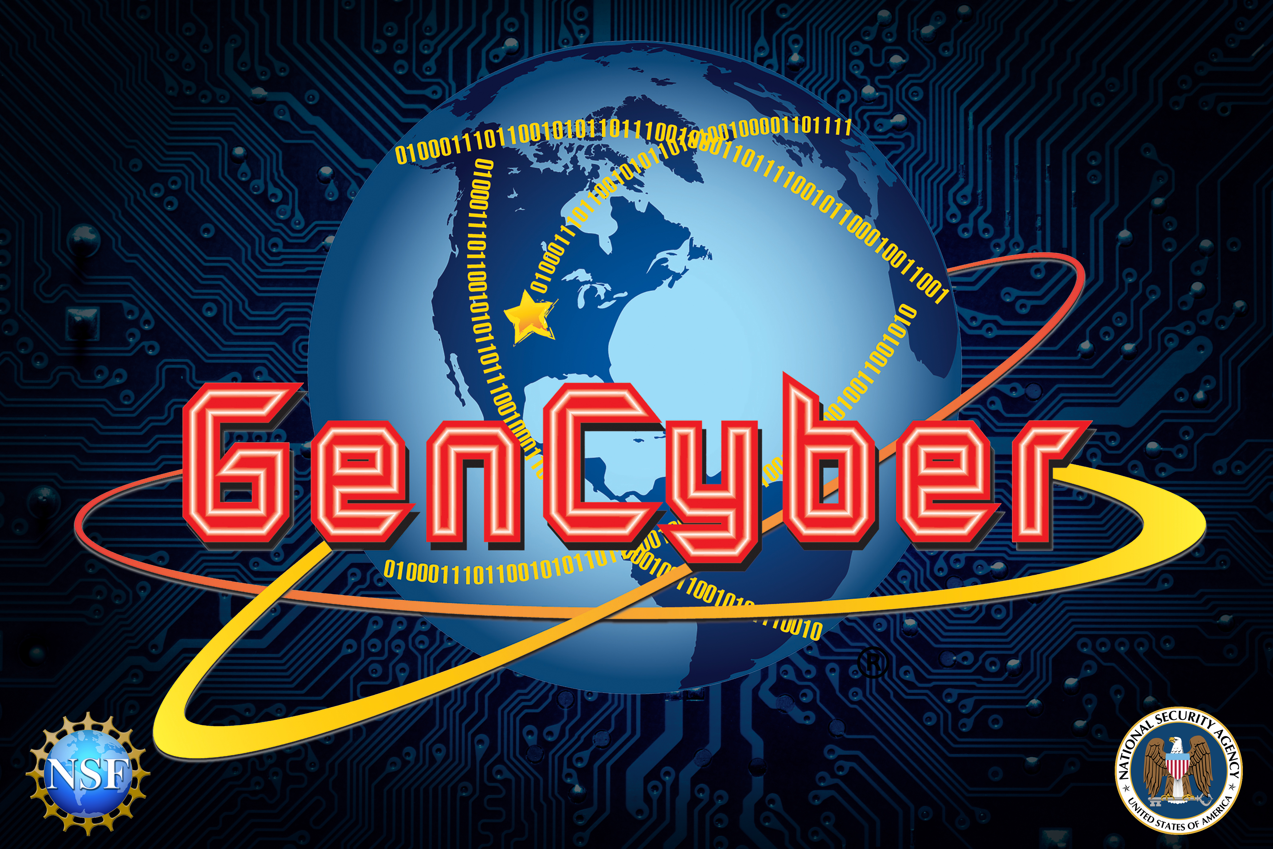

GenCyber Concepts

Slide 2
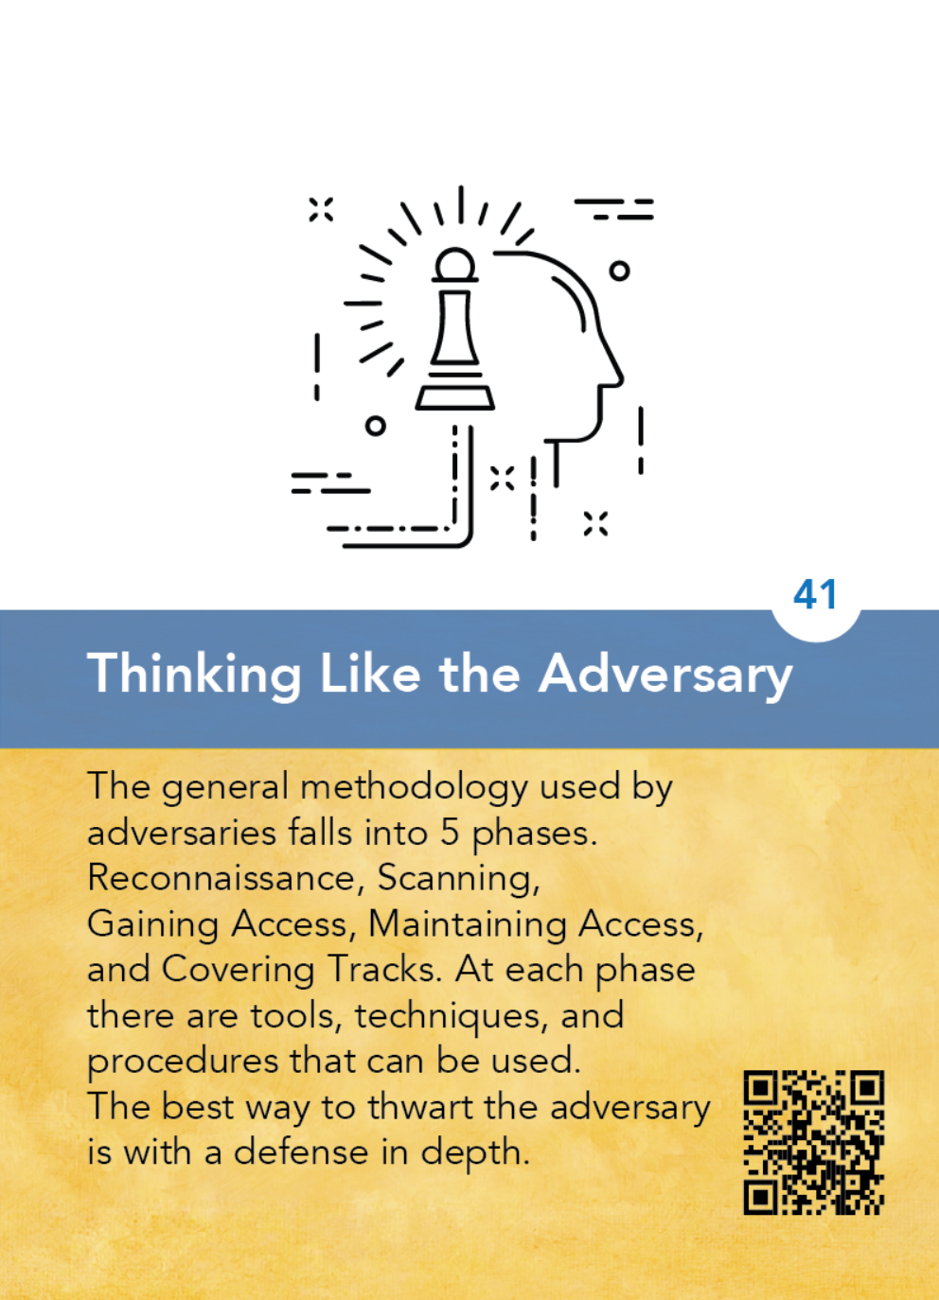
The strategy of putting yourself inside the mindset of a
potential attacker that allows you to anticipate attack strategies and defend your systems accordingly.
In order to best protect a student’s data, it is useful to think of potential adversaries and their motivations, such as a student wishing harm on another, a student seeking to modify his own data, and consider possible strategies – breaking physically into an office, breaching a network to obtain
unauthorized access, etc. and build your security strategy accordingly.

Slide 3
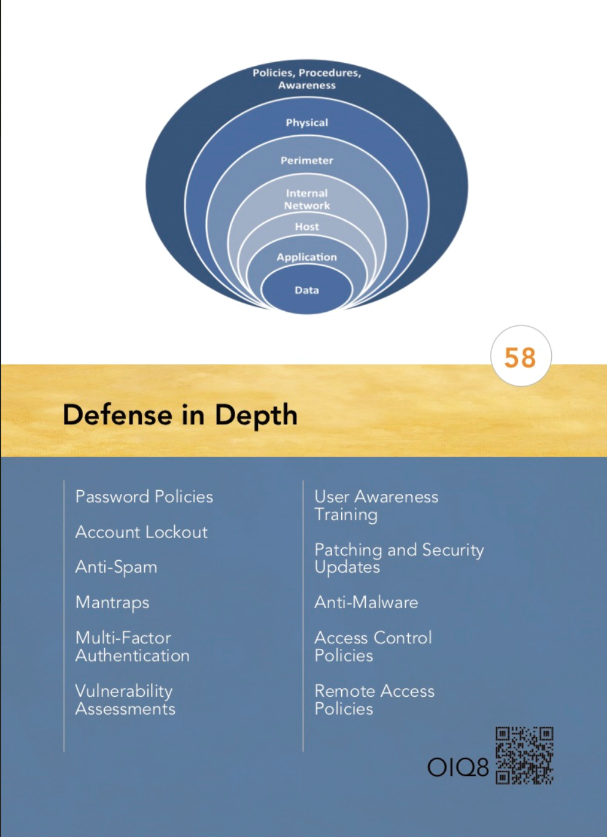
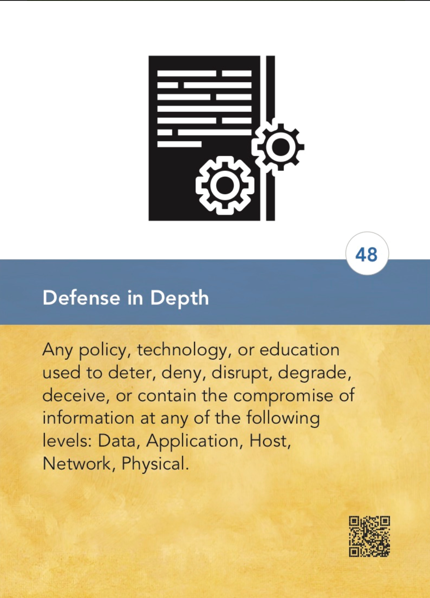
A comprehensive strategy of including multiple layers of security within
a system so that if one layer fails, another layer of security is already in place to stop the
attack/unauthorized access.
• A castle is secured by a moat, a drawbridge and guards at the gate.
• Your home computer is secured by locks on the door, an alarm system, and a
firewall.
• Company data is secured by a firewall, passwords, and encryption.

Slide 4
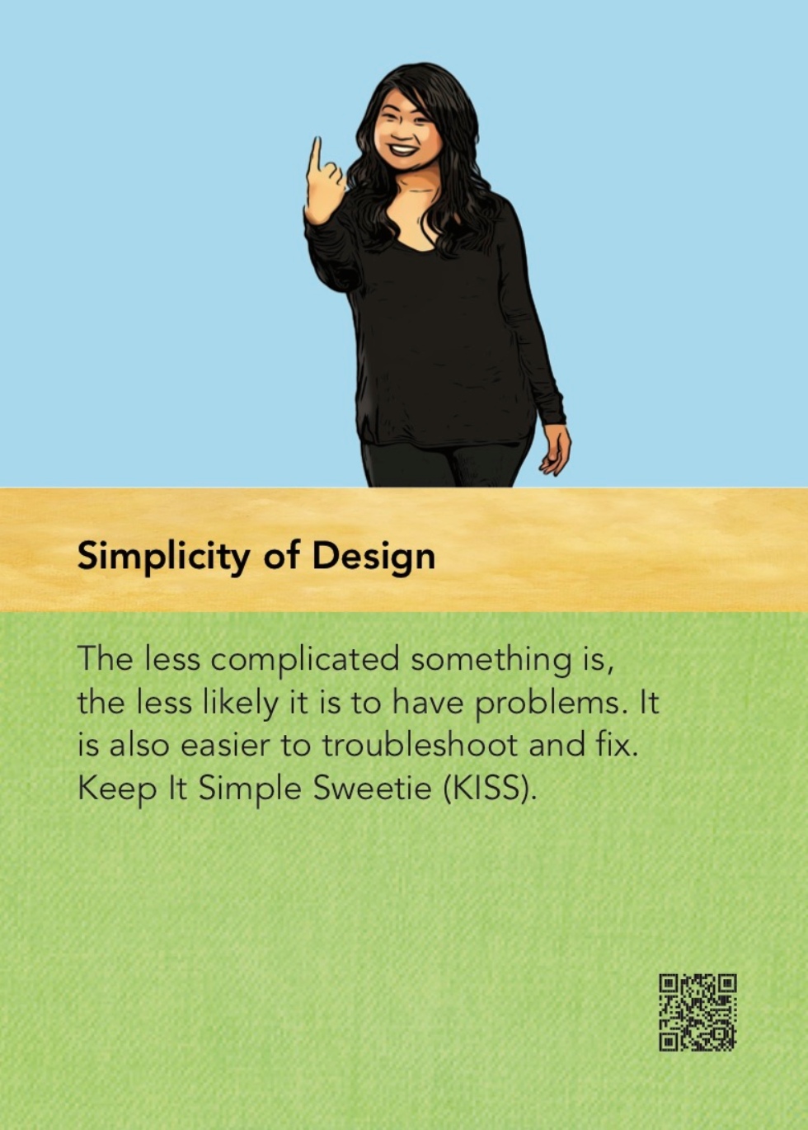
The strategy of designing information and security systems to be configured and operated as simply as possible; all systems perform best when they have simple designs rather than complex ones.
• A complex alarm system can have many points of failure, including the
hardware and the software.
• A complex computer system has many points of access and may be difficult to secure. A simple solution is often the best strategy.

Slide 5
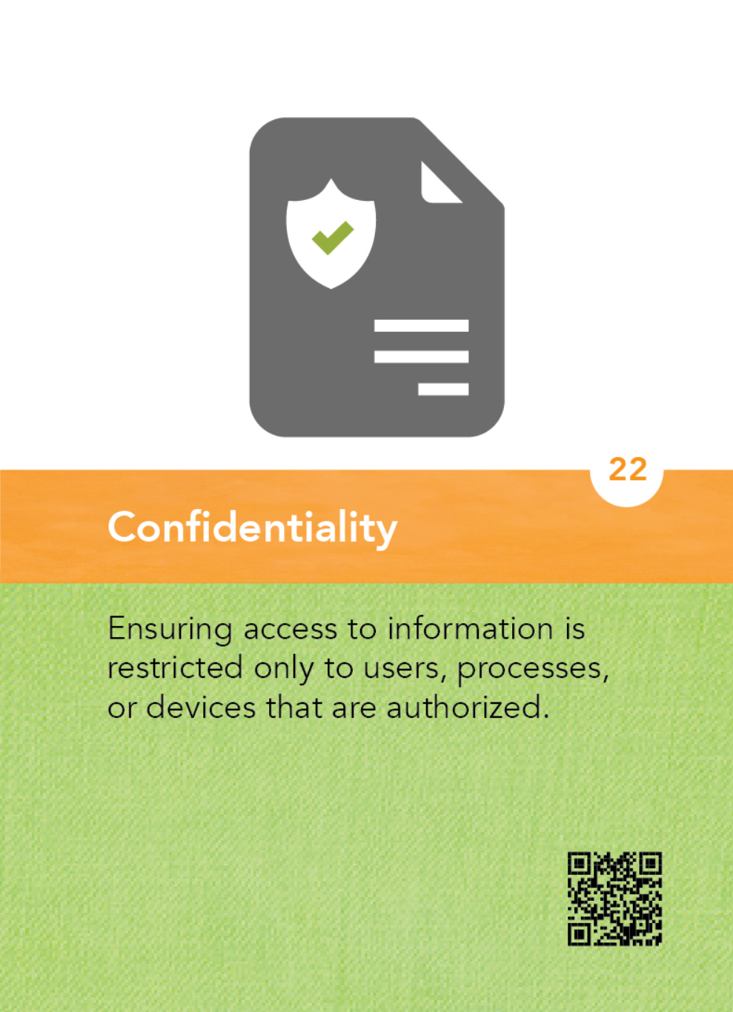
The property that information is not disclosed to individuals, devices, or
processes unless they have been authorized to access the information.
• Student grades can only be accessed by specific individuals within the
organization, such as authorized teachers and the principal.
• At a hospital, medical information about a patient is protected and only
provided to authorized personnel.
• Salary information is typically only available to authorized personnel within a company, such as the supervisor and human resources.

Slide 6
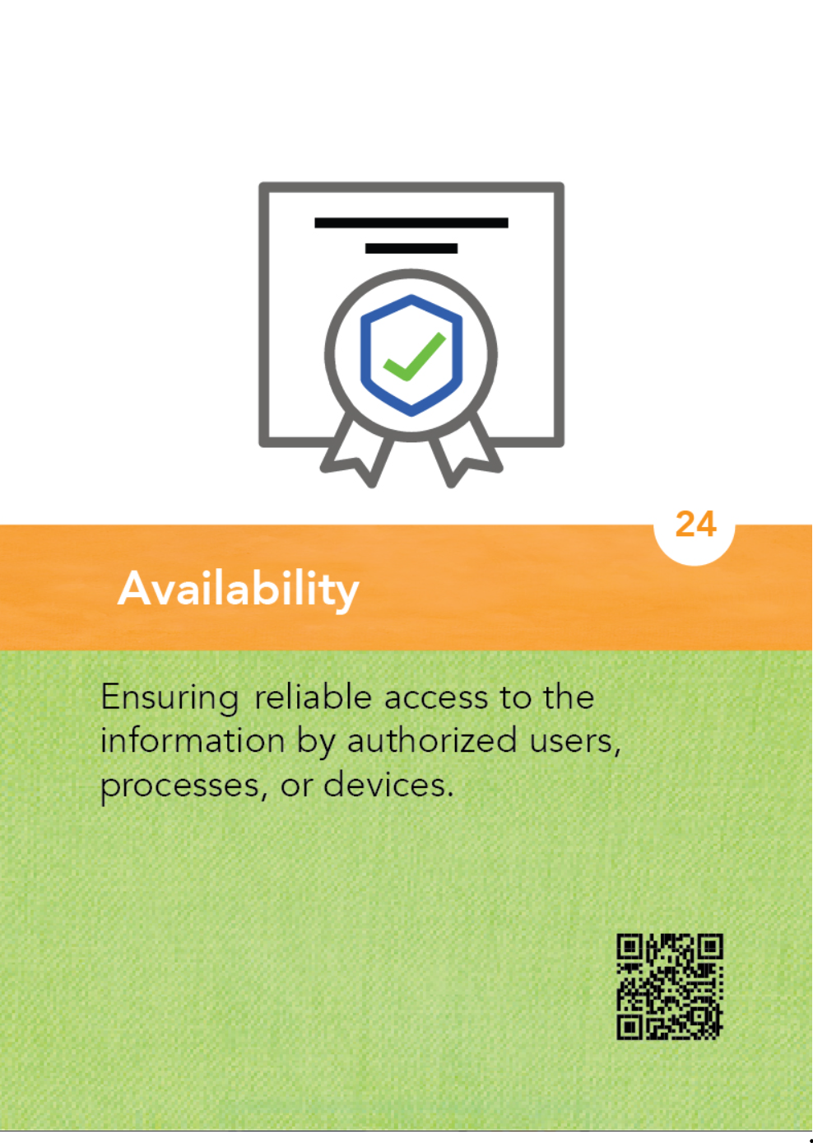
The property that information or information systems are accessible and usable upon demand.
• A student’s grades can be viewed by the student and principal and modified by the teacher.
• A website for a store is allowing orders to be placed and viewed.
• A banking system is appropriately accessible by both customers and banking employees.
• A Denial of Service attack can result in a system being unavailable and inaccessible.

Slide 7
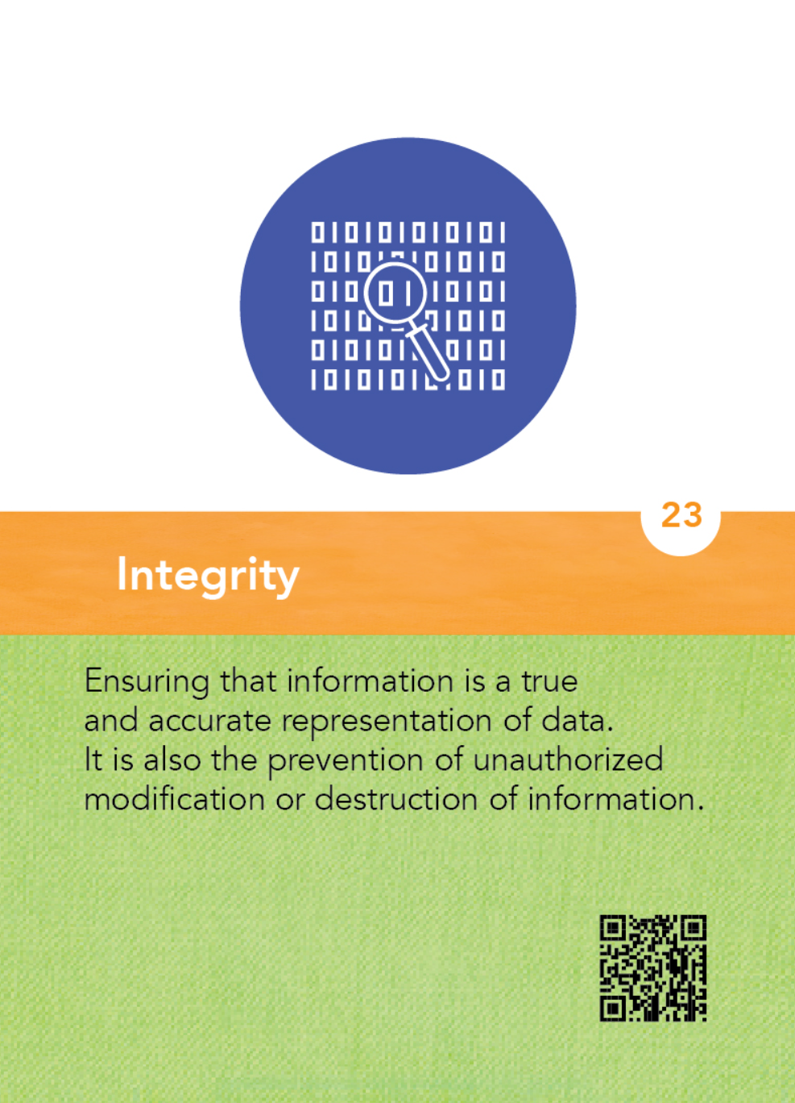
The property that information, an information system, or a component of a system has not been modified or destroyed in an unauthorized manner.
• Student grades are accurate and have not been modified by an unauthorized user.
• A website is the entity it claims to be.
• A computer system is virus-free and uncompromised.

Slide 8
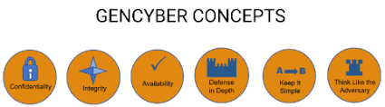
Quick View of the Six Concepts
Thinking Like an Adversary
Defense In Depth
Simplicity of Design (Keep it Simple)
Confidentiality
Integrity
Availability

